Slide 1
CSC479
Data Mining
Hierarichical Clustering
(Ch # 10.3)

Slide 2
Hierarchical Clustering
Use distance matrix as clustering criteria. This method does not require the number of clusters k as an input, but needs a termination condition
Step 0
Step 1
Step 2
Step 3
Step 4
agglomerative
(AGNES)
a
a b
b
a b c d e
c
c d e
d
d e
e
divisive
(DIANA)
Step 4
Step 3
Step 2
Step 1
Step 0

Slide 3
Hierarchical Clustering
Clusters are created in levels actually creating sets of clusters at each level.
Agglomerative
Initially each item in its own cluster
Iteratively clusters are merged together
Bottom Up
Divisive
Initially all items in one cluster
Large clusters are successively divided
Top Down

Slide 4
Distance Between Clusters
Single Link: smallest distance between points. The minimum of all pair wise distances between points in the two clusters
Tends to produce long, “loose” clusters
Complete Link: largest distance between points. The maximum of all pairwise distances between points in the two clusters
Tends to produce very tight clusters
Average Link: the average of all pairwise distances between points in the two clusters
Centroid Linage: distance between centroids

Slide 5
Linkage Rules
Single Link
Complete Link
Average Link
MST Single Link

Slide 6
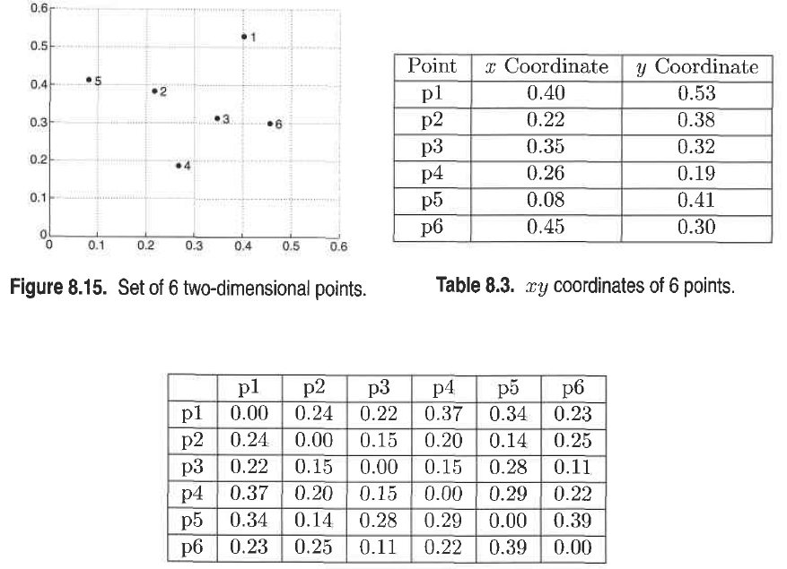

Slide 7
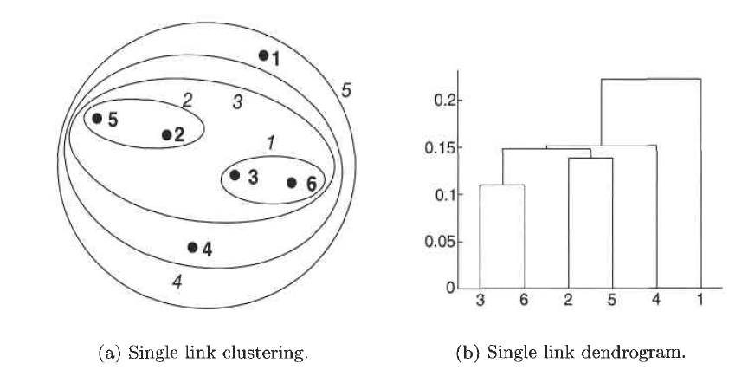
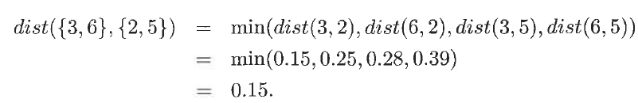

Slide 8
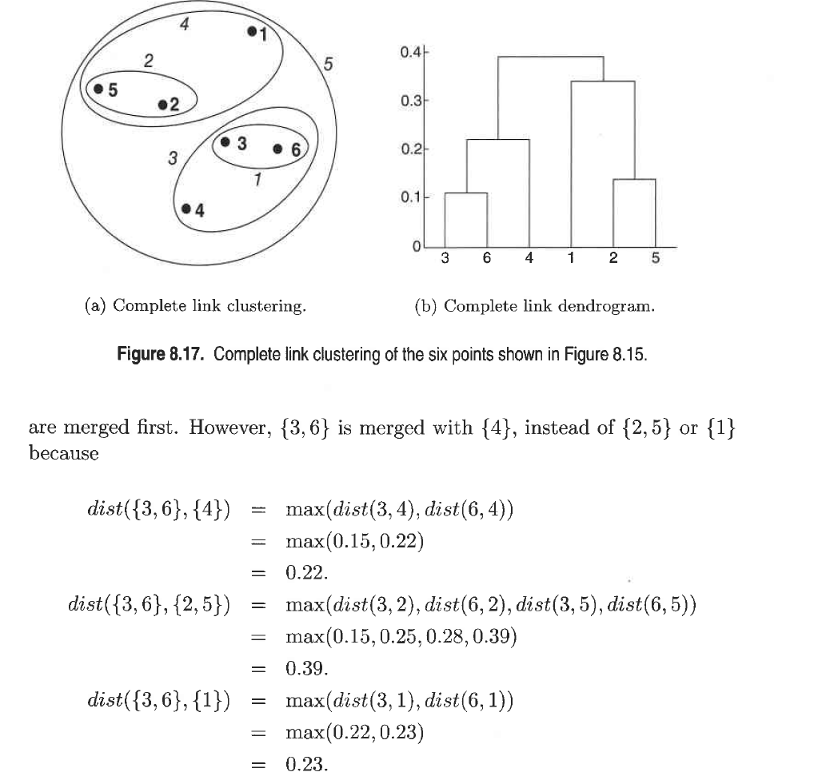

Slide 9
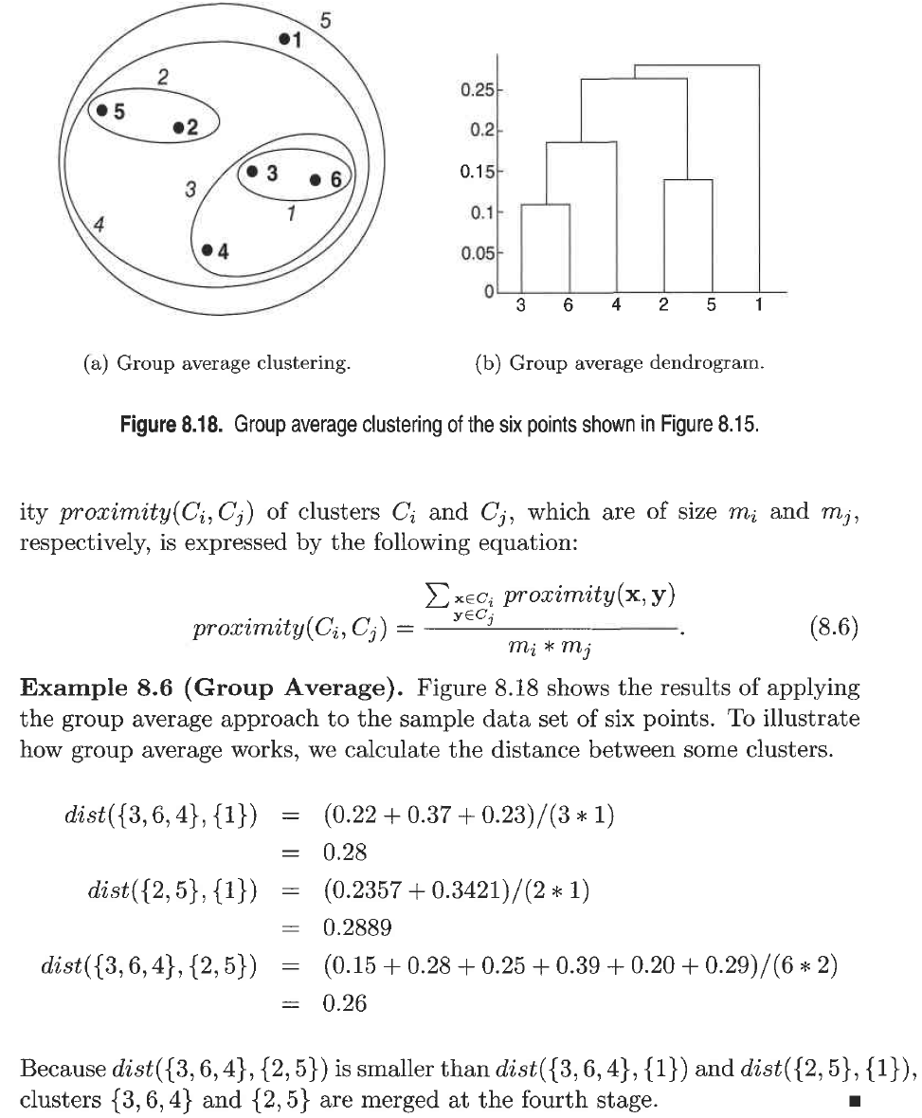

Slide 10
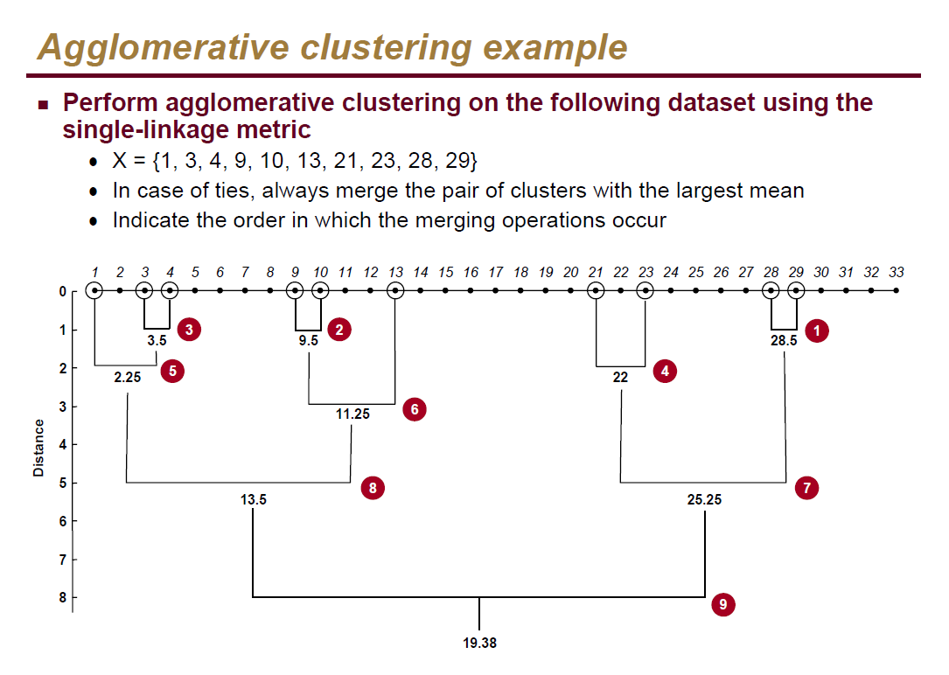
Single Link - Example

Slide 11
